Slide 1
Python loops
Life Choices Coding Academy 2020

Slide 2
Learning outcome:
By the end of this section, student should be able to:
Construct and make use a while loop
Construct and make use use a for loop
List differences between while loop and a for loop
Make use of the break and continue keywords
List differences between the xrange() and range() functions

Slide 3
LooPS intro...
Important in Python or any other programming language.
Helps repeat a statement or group of statements.
Notes:
Loops are part of our daily life. Think about all things you do repeatedly.
For the length of this road, drive.
While you’re at work, do work.
For the duration of this lecture, stay awake.
While you still feel hungry, eat.
Loops make world go round.
Loops/Repetition/Iterations.

Slide 4
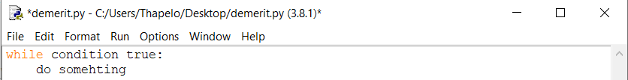
While Loop
Useful when you don’t know when you want to stop looping.
Three components that you need to construct a while loop:
The while keyword;
A condition that translates to either True or False.
And a block of code that you want to run repeatedly.
Notes:
A while loop is a programming concept that, when it's implemented, executes a piece of code over and over again while a given condition still holds true.
While - is a pretest loop meaning a condition is tested before execution of statement.

Slide 5

While Loop Example...
Notes:
You can add as many conditions in your while loop
Demonstrate infinite loop.
Remember to increment gas, or else the loop will continue forever.
Prints Vroom 45 times. Do the easy maths.

Slide 6
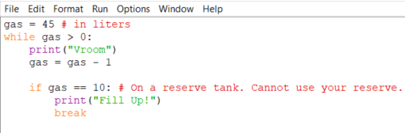
The break Statement
With the break statement we can stop the loop even if the while condition is true.
Notes:
Stops executing when gas == 10
When a break statement is encountered inside a loop, the loop is immediately terminated and the program control resumes at the next statement following the loop.

Slide 7
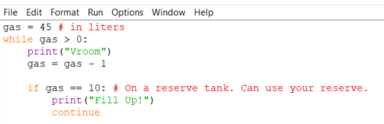
The continue Statement
It returns the control to the beginning of the while loop.
Can be used in both while and for loops
Notes:
Does not stops executing when gas == 10
Also demonstrate that a while has an optional else (runs when the given condition is false.)

Slide 8
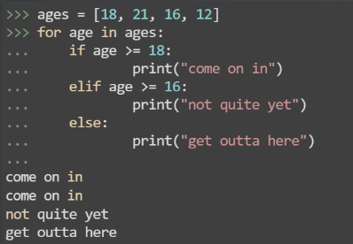
Python For Loops
A for loop is used for iterating over a sequence (that is either a list, a tuple, a dictionary, a set, or a string.)
With the for loop we can execute a set of statements, once for each item in a list, tuple, set etc.
Notes:
We can modify this code at this stage to get input from the user.

Slide 9
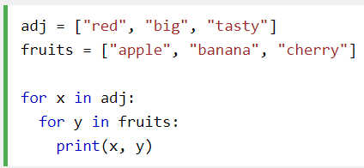
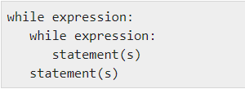
Nested Loops
A nested loop is a loop inside a loop.
The “inner loop” will be executed one time for each iteration of the “outer loop”:
Notes:
Python allows you to use one loop inside another loop.
A note on loop nesting is that you can put any type of loop inside of any other type of loop. For example a for loop can be inside a while loop vice versa.

Slide 10

The range() Function
To loop through a set of code a specified number of times, we can use the range() function.
The range() function returns a sequence of numbers, starting from 0 by default, and increments by 1 (by default), and ends at a specified number.
Notes:
Note that range(6) is not the values of 0 to 6, but the values 0 to 5.
The range(functions) defaults to 0 as a starting value, however it is possible to specify the starting value by adding a parameter: range(2,6), which means values from 2 to 6 (but not including 6)

Slide 11


The pass Statement
Loops cannot be empty, but if for some reason you have a loop with no content, put in the pass statement to avoid getting an error.
Notes:
You will also see later you can also use a pass on functions()

Slide 12
Exercise time :)

Slide 13
Exercise 1
Write a short program that prints each number from 1 to 100 on a new line.
For each number, if it is divisible by 3, print “Fizz” instead of the number.
If it’s divisible by 5, print “Buzz” instead of the number.
For numbers which are divisible by both 3 and 5, print “FizzBuzz” instead of the number.
Sample Output:
1
2
Fizz
4
Buzz
etc….
Notes:
https://www.hackerrank.com/challenges/fizzbuzz/problem
This is a typical interview question.
More thoughts available here: https://blog.codinghorror.com/why-cant-programmers-program/

